Slide 1
SEIS 631

Slide 2
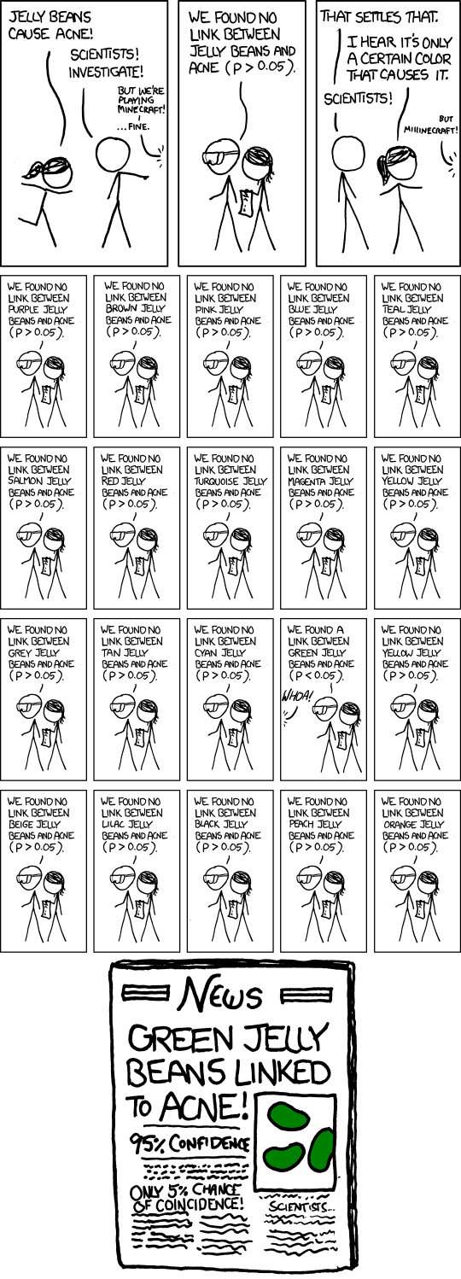
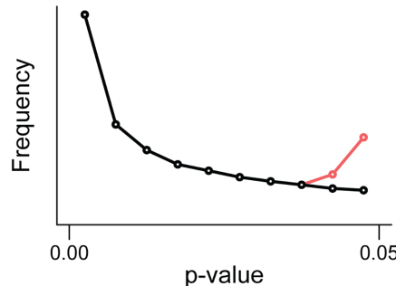
Statistical Issues P-value Hacking

Slide 3
Statistical Error
 | Null Hypothesis (Truth)
Decision | False | True
Reject | Correct Decision (prob = 1 – β) | Type I error (prob = α)
Fail to Reject | Type II Error (prob = β) | Correct Decision (prob = 1 – α)
Type I error: Rejecting the null when it is true in reality (with probability of α, typically set at 0.05)
Type II error: Failing to reject the null when it is false in reality (with probability of β)

Slide 4
Type I vs. Type II error
The villagers in the boy who cried wolf:
“Wolf!!” They come running --- Type I Error
“Wolf!!” They come running --- Type I Error
“Wolf!!” They come running --- Type I Error
“No really, wolf!!” They DON’T come running --- Type II Error

Slide 5
Statistical Power
Power: The probability of rejecting the null hypothesis when it’s false
Power = 1 – β = 1 – probability of Type II error
Significance level: (α) our threshold of whether or not to reject the null
 | Null Hypothesis (Truth)
Decision | False | True
Reject | Correct Decision (prob = 1 – β) Power | Type I error (prob = α) Significance
Fail to Reject | Type II Error (prob = β) | Correct Decision (prob = 1 – α)

Slide 6
Statistical Power - Intuition
Scientific test is like an instrument used to detect something (ex. Telescope)
Powerful telescope will let you see the moons of Mars
Cannot see them with binoculars (underpowered test)
The moons are still there, but our ability to detect them depends on the power of our test

Slide 7
Increasing statistical power
Increase alpha
Set at the beginning of experiment
Conduct one tailed test
Have to decide before experiment
Decrease random error
Through more advanced sampling and experimental techniques
Increase sample size
Depending on the situation, this is the most straightforward!

Slide 8
Tradeoff of Power
UK 1995: Committee on Safety of Medications issued a warning that a certain birth control pill increased the risk of a dangerous embolism 100%
Risk went from about 1 in 7000 to 2 in 7000
Results were statistically significant, but not practically.
This warning was blamed for 13,000 unwanted pregnancies and may have saved 2 to 6 people per 10,000,000 users
Powerful tests will pick up a “real” effect, however, the effect may not be meaningful, so we may be better off not being as sensitive.
High power: Detect “truth”, but may be too “sensitive”
Low power: Fail to detect “truth”, but don’t “overreact”

Slide 9
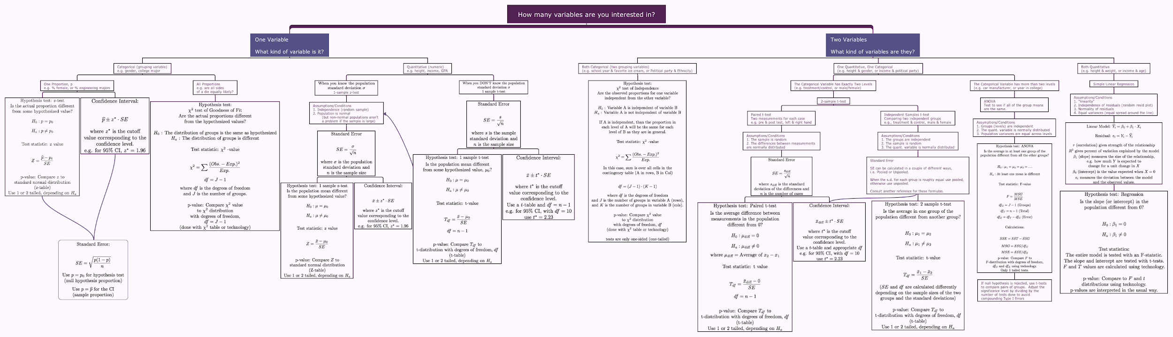

Slide 10
Hypothesis Testing with Numeric Data

Slide 11
One Sample z-test Example
Boys of a certain age are known to have a mean weight of μ = 85 pounds. A complaint is made that the boys living in a municipal children's home are underfed. As one bit of evidence, n = 25 boys (of the same age) are weighed and found to have a mean weight of x = 80.94 pounds. It is known that the population standard deviation σ is 11.6 pounds (the atypical part of this example!). Based on the available data, what should be concluded concerning the complaint?

Slide 12
One sample z-test Example
What question are we trying to answer?
Are the boys sufficiently underweight to convince us they are being underfed?
What are the Null and Alternative Hypothesis?

Slide 13
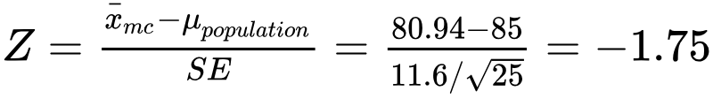
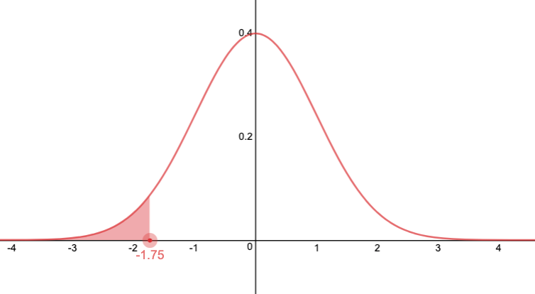
One sample z-test Example
What test?
We are comparing two means (μ_{mc} and μ_{population})
We know the population standard deviation
→ Z-test
Calculate the test statistic

Slide 14
One sample z-test Example
Calculate the p-value (with R):
> pnorm(-1.75)
[1] 0.04005916
or
> pnorm(80.94,85,11.6/sqrt(25))
[1] 0.04005916
p = 0.04

Slide 15
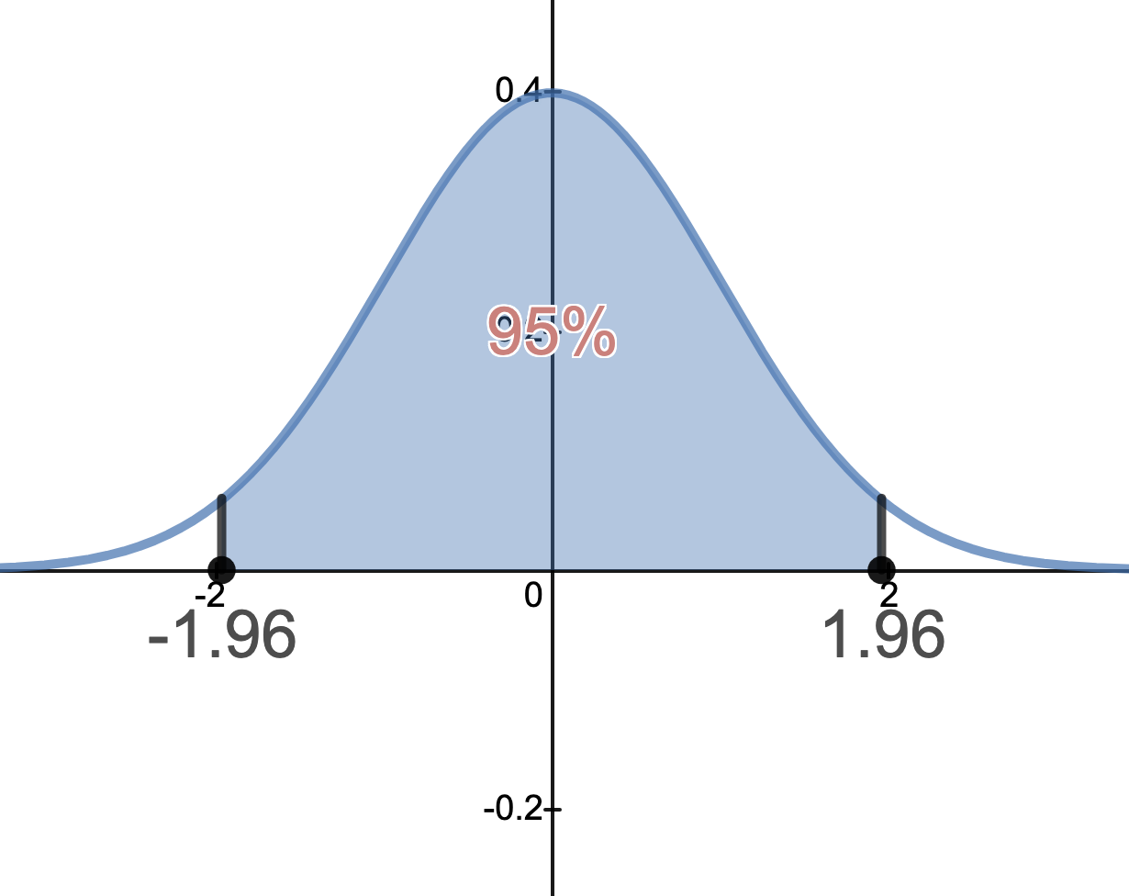
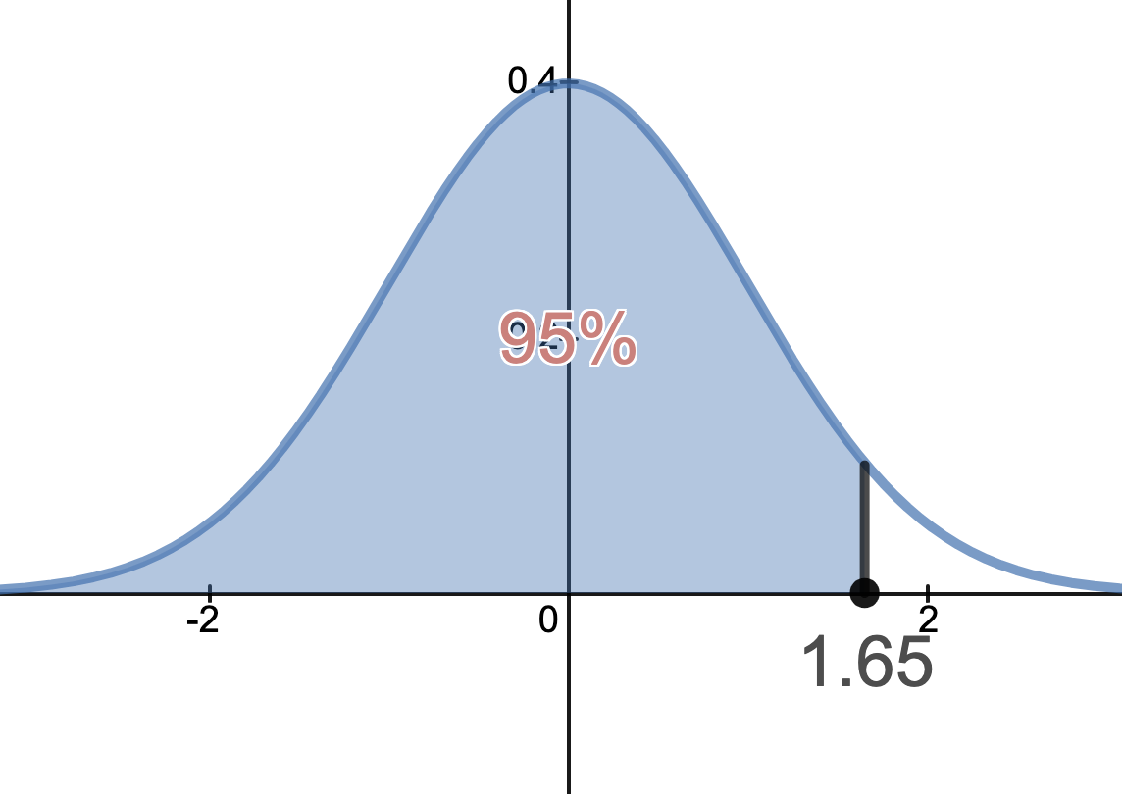
One sample z-test Example
Calculate the 95% CI: This is a one sided test, so we can construct a 1-sided CI. For a 1-sided CI we put no limit on either the upper bound or lower bound.
Instead of saying we are 95% confident μ is in [a, b]
We say we are 95% confident μ < b (or μ > a).
In this case, we lump all the error on one side so we will get different z* values.

Slide 16
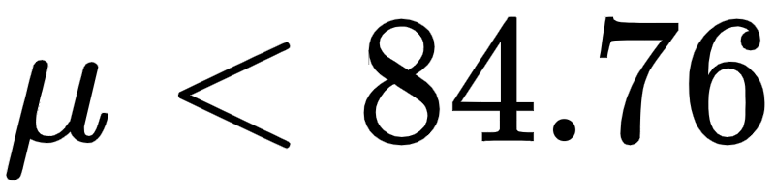
One sample z-test Example
For this example, we want all the error on the positive side.
We may have underestimated the weight, i.e. the actual weight is higher (which might change our conclusion). How high could it reasonably be?
If it is actually lower than we estimated, it wouldn’t change our conclusion (at least for this test).
CI:
We are 95% confident that the true average is less than 84.76 lbs.

Slide 17
One sample z-test Example: Conclusion
Result of Test
P-value: p = 0.04
CI:
Conclusion
We are 95% confident that true average weight for boys at the municipal center is less than 84.76 lbs. Values in this interval are reasonably compatible with our data.
The p value indicates that if we assume the average weight for boys at the municipal center is 85 lbs (and we have met all model assumptions) then the probability of collecting data like this or more extreme is 4% (1 in 25).
Are the boys being underfed?

Slide 18
Difference of two means - Confidence intervals for differences of means - Hypothesis tests for differences of means

Slide 19
Hours Worked & Education
Do people with more education work more, less, or about the same as those with less education?
How could we investigate this?

Slide 20
The General Social Survey (GSS)
Large scale survey conducted by the Census Bureau each year
First started in 1972
Many questions have remained the same

Slide 21
Hours Worked & Education
Here are some data from the 2010 GSS. The variables are
degree: Level of highest educational attainment
hrs1: Number of hours worked per week
Is there a relationship? How should we start?
# A tibble: 1,172 x 2
degree hrs1
<fct> <int>
1 BACHELOR 55
2 BACHELOR 45
3 JUNIOR COLLEGE 45
4 HIGH SCHOOL 40
5 HIGH SCHOOL 48
6 JUNIOR COLLEGE 26
7 HIGH SCHOOL 40
8 BACHELOR 50
9 HIGH SCHOOL 40
10 HIGH SCHOOL 25
# … with 1,162 more rows

Slide 22
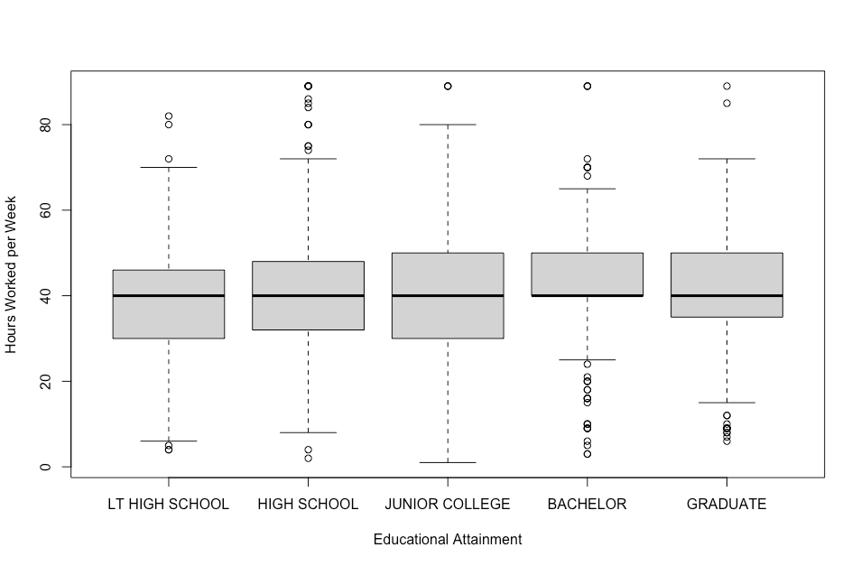
Hours Worked & Education
Side by Side Boxplots
What can you say about the relationship between the variables?

Slide 23
z-test
Can we use a z-test to test our hypothesis?
No
z-tests can only compare two means
Can we manipulate our data so that a z-test will apply?

Slide 24
Collapsing Data
Sometimes it makes sense to collapse similar or related groups together. In this case we might think of HS as a dividing line:
HS or Lower: Less than HS and HS from the original data set
College or Higher: Junior College, Bachelors, and Graduate from the original data set
Now we have two groups that we can compare

Slide 25
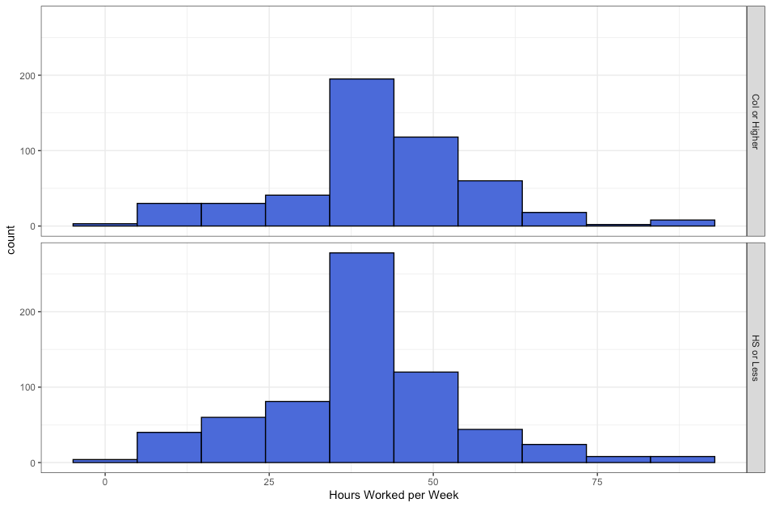
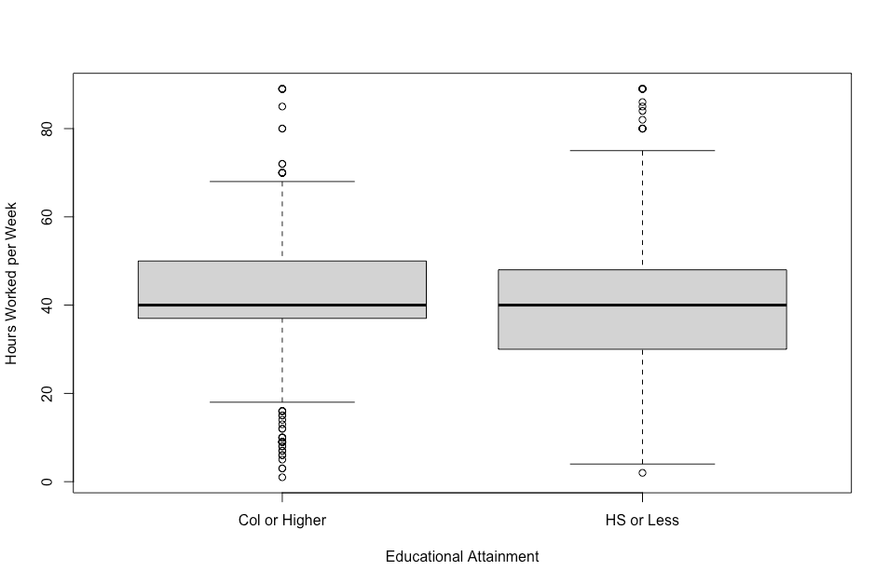
College or More vs. HS or Less
Education mean sd n
* <chr> <dbl> <dbl> <int>
1 Col or Higher 41.8 15.1 505
2 HS or Less 39.4 15.1 667
Do you think there is a true difference?
Notes:
df <- original data
df$col.edu <- ifelse(education %in% c(“Less than HS”,”HS”), “HS or Less”, “Col or Higher”)

Slide 26
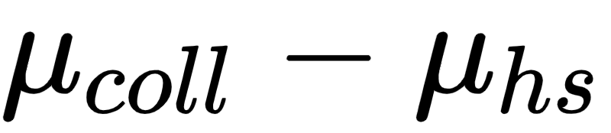
Difference Between Two Means
The difference between the sample means is
Education mean sd n
* <chr> <dbl> <dbl> <int>
1 Col or Higher 41.8 15.1 505
2 HS or Less 39.4 15.1 667
Can we use this sample difference to estimate the true difference in the population?

Slide 27
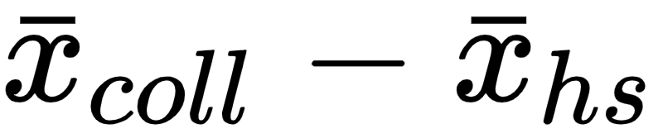
Difference Between Two Means
What is the difference in the average number of hours worked per work by Americans with a college degree or higher and those with a high school diploma or lower?
Parameter of interest: Difference between the average number of hours worked per week by all Americans with a college degree and the average number of hours worked per week by all Americans with high school diploma or lower.
Point estimate: Difference between the average number of hours worked per week by sampled Americans with a college degree and the average number of hours worked per week by sampled Americans with high school diploma or lower.

Slide 28
Applying the Central Limit Theorem
We can apply what we know about the sampling distribution from the Central Limit Theorem as long as the model assumptions or conditions are met.
Independence within groups: Are individuals independent of each other?
Both groups are sampled randomly (GSS methodology)
Both groups are much smaller than the populations so sampling without replacement is fine
Independence between groups: Are the two groups independent?
Again, since all individuals are sampled randomly this condition is satisfied.
Sample size / skew: Will the sampling distribution be sufficiently Normal?
Both groups have fairly large sample sizes (505 and 667)
Both histograms and boxplots, although not perfectly symmetric, don’t show any major skewness, so we can be confident that the sampling distribution will be nearly Normal.

Slide 29
Confidence Interval
The difference between samples was 2.4 hours, which leads to an estimate of the true difference as 2.4 hours as well. Can we build a confidence interval around that difference?
Confidence Interval: point estimate ± ME (as always)
Margin of Error: ME = critical value x SE of the point estimate
But what’s the SE for the difference between two means?

Slide 30
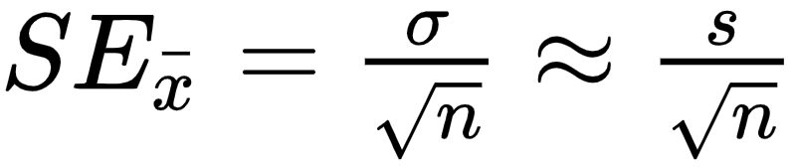
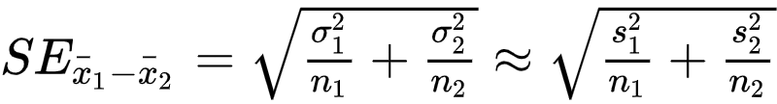
Standard Error
Standard Error for a single mean:
Standard Error for the difference between two means:

Slide 31
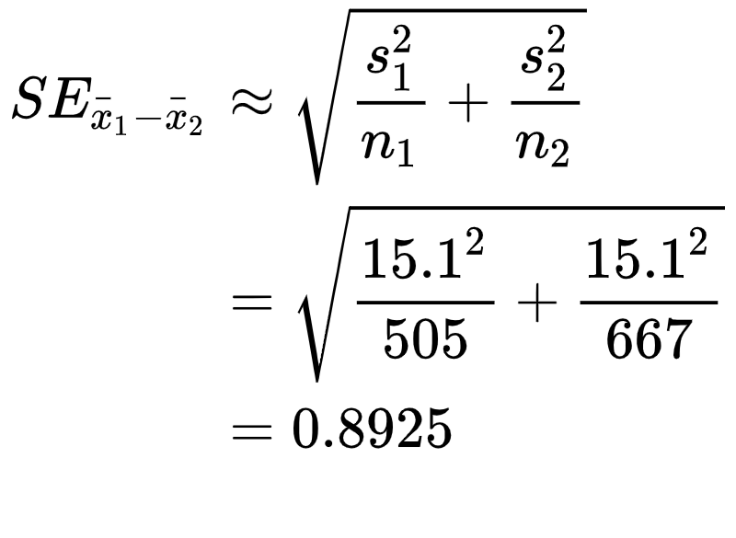
Standard Error
Calculate the SE for the difference in the mean number of hours worked for college and above vs. high school and below.
Education mean sd n
* <chr> <dbl> <dbl> <int>
1 Col or Higher 41.8 15.1 505
2 HS or Less 39.4 15.1 667

Slide 32
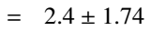
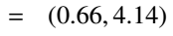
Confidence Interval
Build a 95% Confidence Interval for the difference between the two means.
Education mean sd n
* <chr> <dbl> <dbl> <int>
1 Col or Higher 41.8 15.1 505
2 HS or Less 39.4 15.1 667
SE_{x1-x2} = 0.893

Slide 33
Question
Which of the following is the best interpretation of the confidence interval we just calculated?
We are 95% confident that...
The difference between the average number of hours worked per week by college grads and those with a HS degree or lower is between 0.66 and 4.14 hours.
College grads work an average of 0.66 to 4.14 hours more per week than those with a HS degree or lower.
College grads work on average 0.66 hours less to 4.14 hours more per week than those with a HS degree or lower.
College grads work on average 0.66 to 4.14 hours less per week than those with a HS degree or lower.
Notes:
Is the best answer. The others either have the direction wrong or refer to the average of the difference rather than the difference of the average.

Slide 34
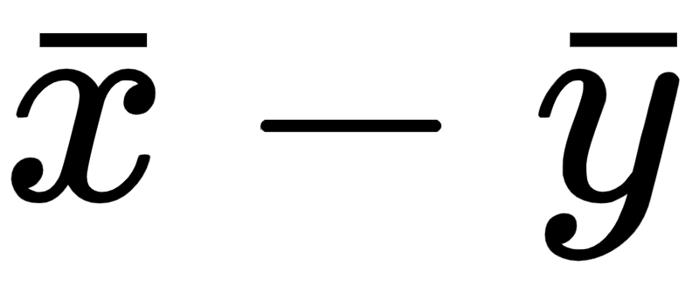
Careful with Differences
There is a subtle difference between looking at the average of the differences and the difference of the averages…
Vs

Slide 35
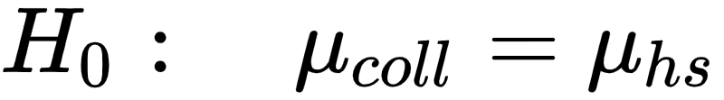
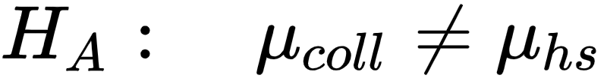
Hypothesis Test
Is there a difference between the average number of hours worked per week by people with college education and the average hours worked per week by those with a HS diploma or lower?
What are the hypothesis?
There is no difference in the average number of hours worked per week by those with a college education and those with a HS diploma or lower. Any observed difference between the sample means is due to natural sampling variation (chance).
There is a difference in the average number of hours worked per week by those with a college education and those with a HS diploma or lower.

Slide 36
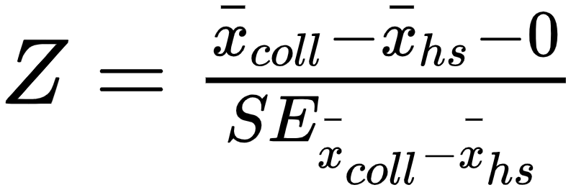
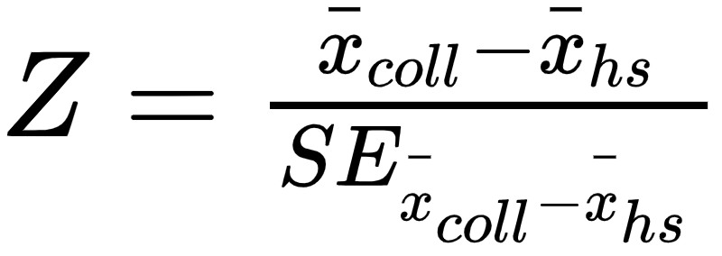
Test Statistic
TEST: z-test
TAILS: two-tailed
TEST STATISTIC FOR THE DIFFERENCE OF MEANS:
or

Slide 37
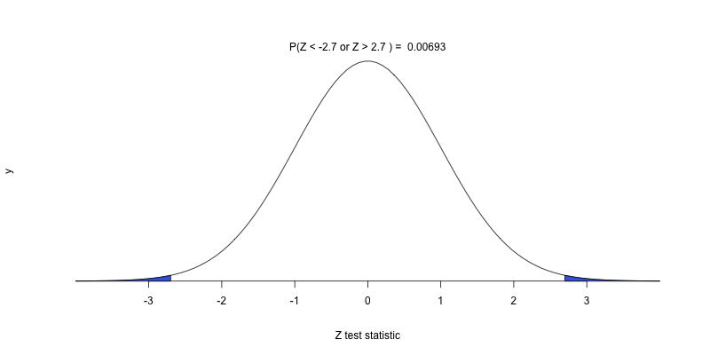
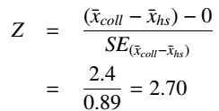

Calculating the Test Statistic & p-value
Upper or Lower tail: 0.00347
p-value = 0.00693

Slide 38
What’s the conclusion of the test?
Which of the following is best supported by the results of the hypothesis test we just conducted?
There is 0.7% chance that there is no difference in the average number of hours worked per week between the two groups.
Since the p-value is low, we reject H₀. The data provide convincing evidence of a difference in the average number of hours worked per week between the two groups.
Since we rejected H₀, we may have made a Type 2 error.
Since the p-value is low, we fail to reject H₀. The data do not provide convincing evidence of a difference in the average number of hours worked per week between the two groups.

Slide 39
t - distribution

Slide 40
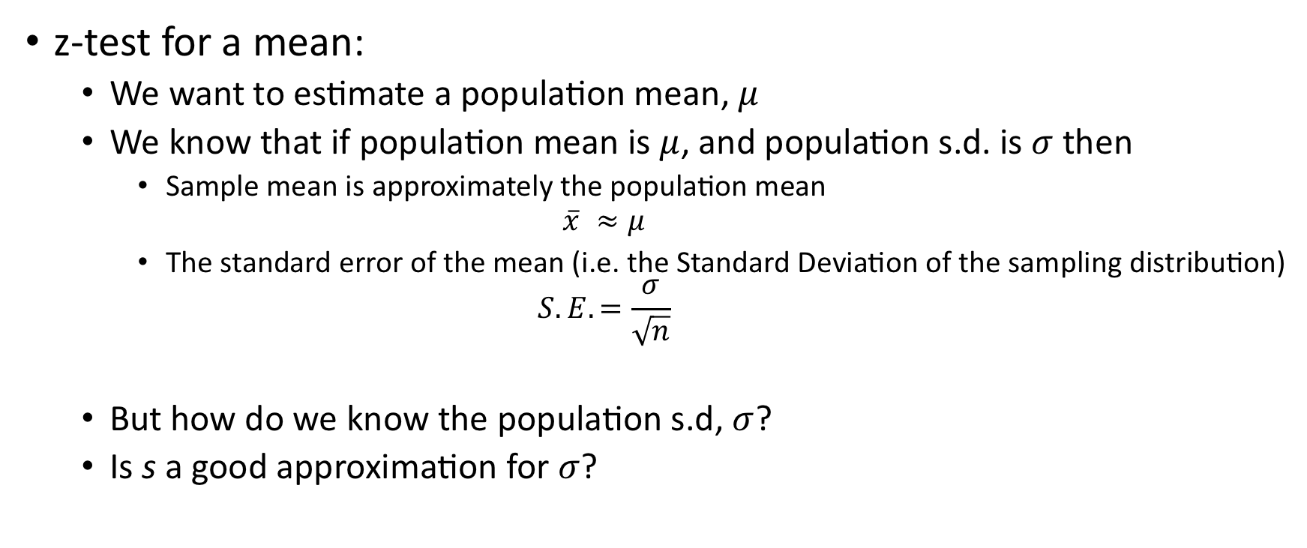
Are z-tests really practical?

Slide 41
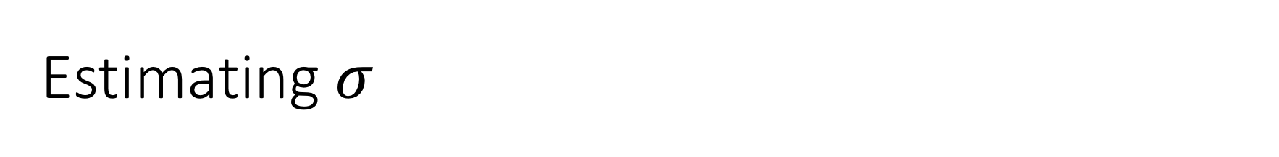
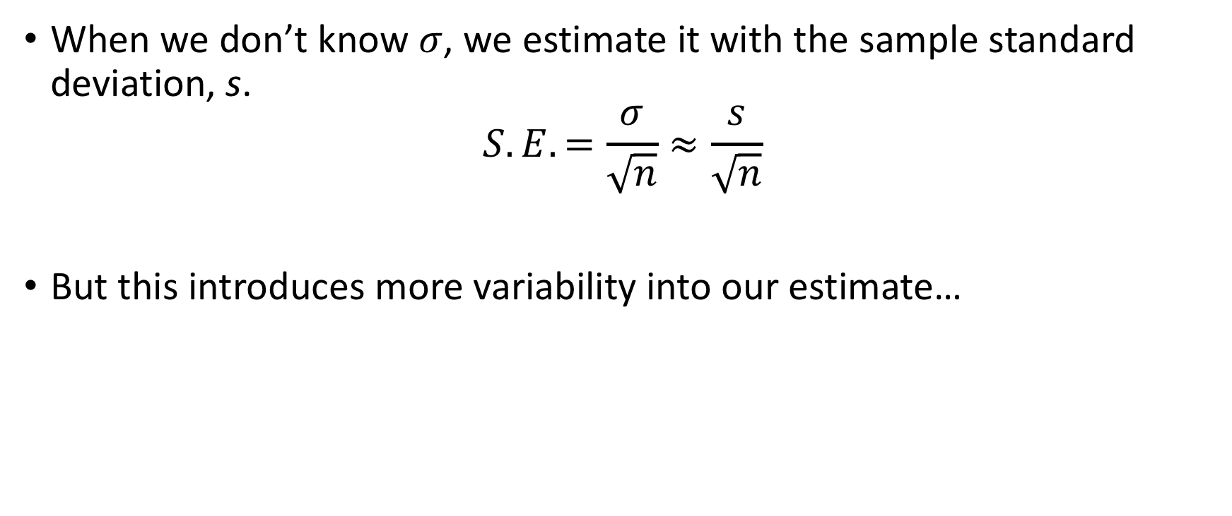

Slide 42
William Gosset
Guiness Brewery
Quality Testing on Grain Samples
Quickly test a small sample
If bad, send off for more comprehensive testing (i.e. larger sample)
With significance level of 5%, he expected 5% of batches to come back as actually ok…
…But actually much more came back

Slide 43
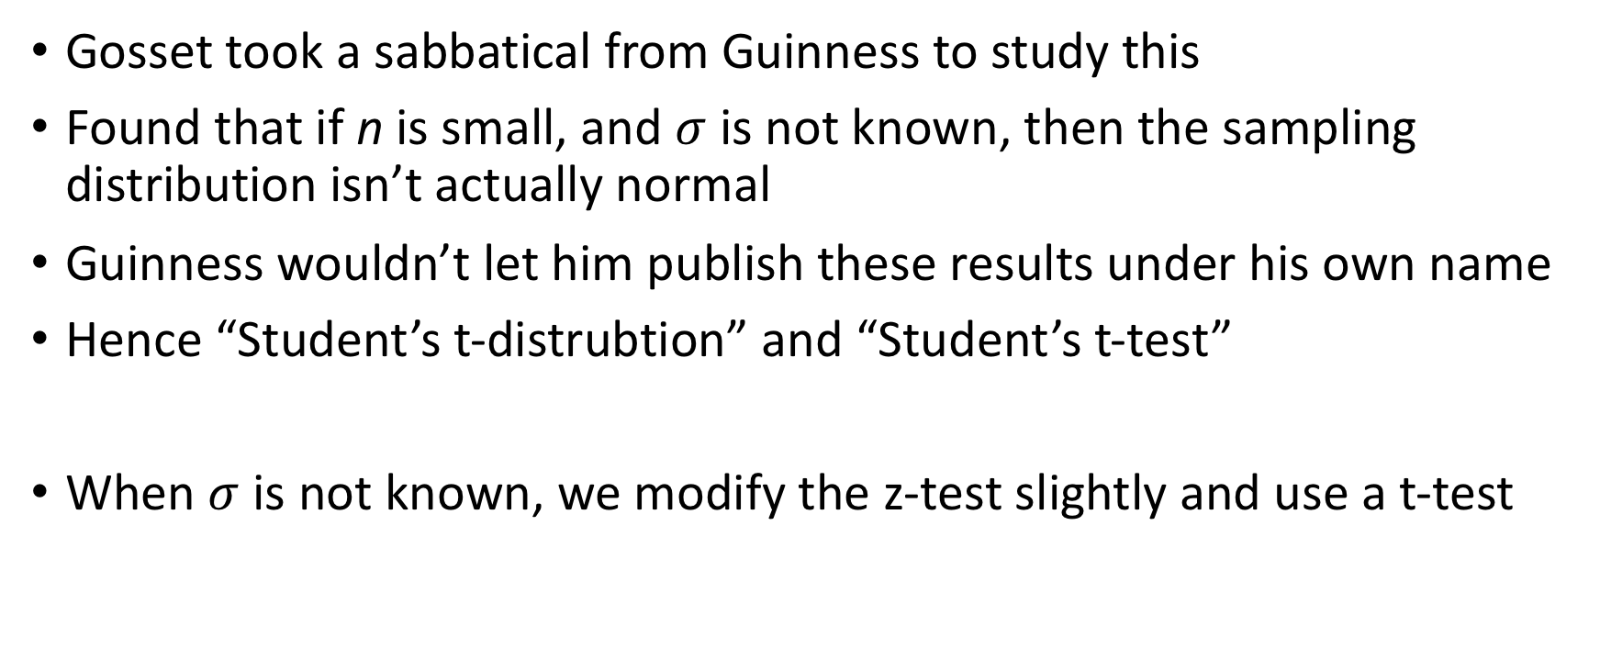
Student’s t-test

Slide 44
t-Tests
t-tests start the same as z-tests and are very similar.
We’ll about the t-test by starting the hypothesis test process then seeing where it deviates from a z-test.
Example:
Is Friday the 13th unlucky?
Do people change their behavior?

Slide 45
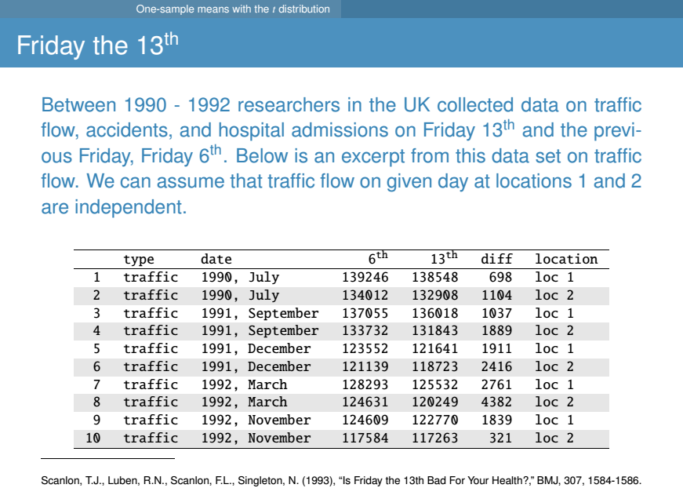

Slide 46

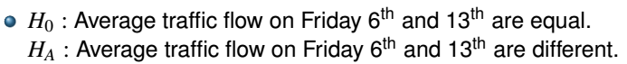
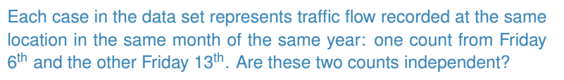

Slide 47
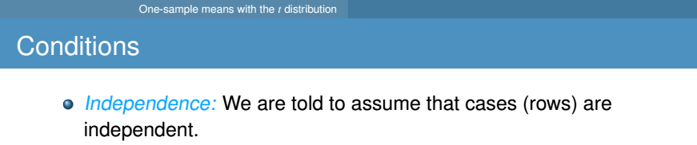

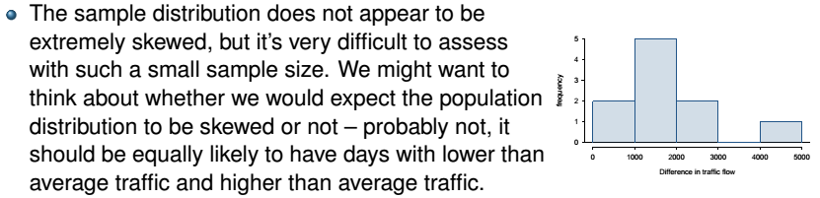


Slide 48
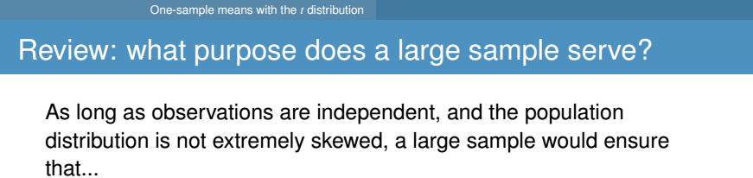
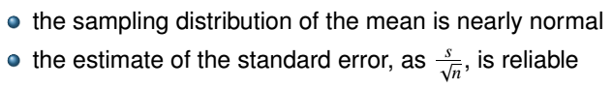

Slide 49

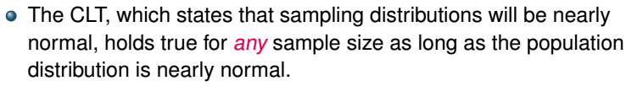
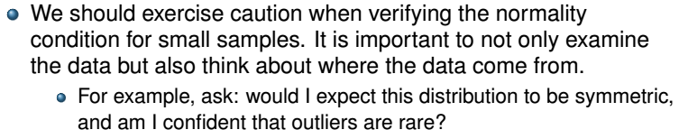

Slide 50
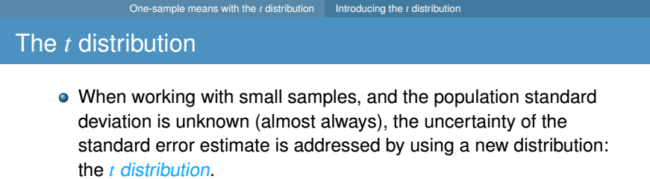
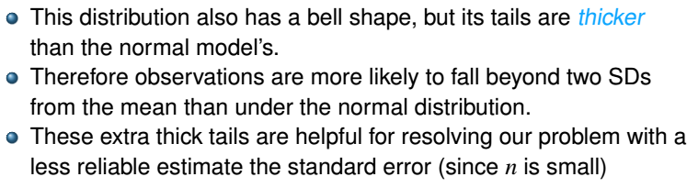
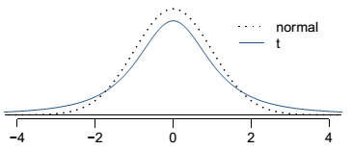

Slide 51
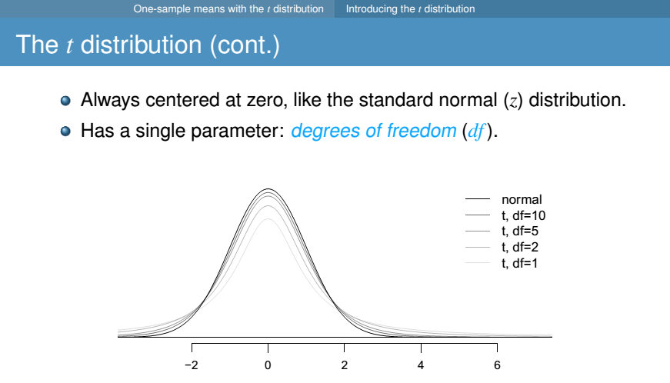

Slide 52
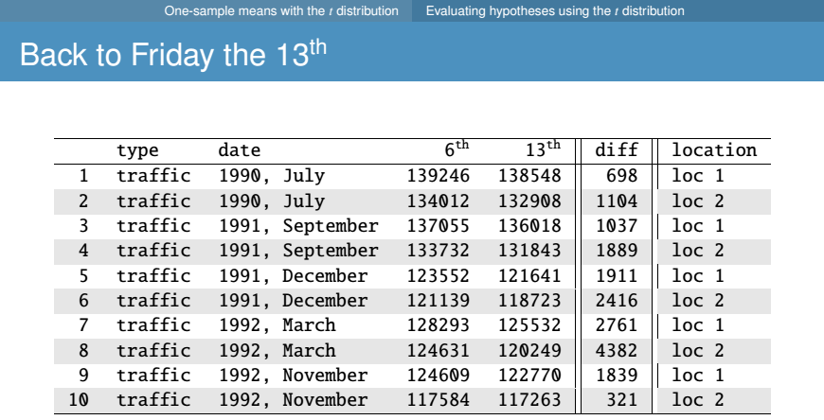
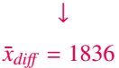

Slide 53
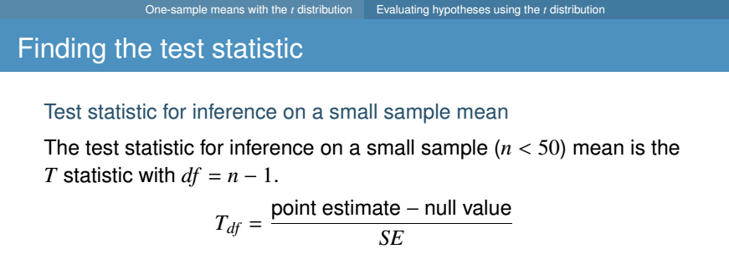
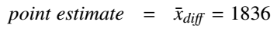
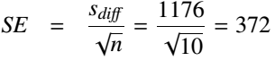
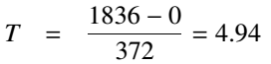
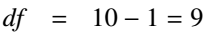

Slide 54
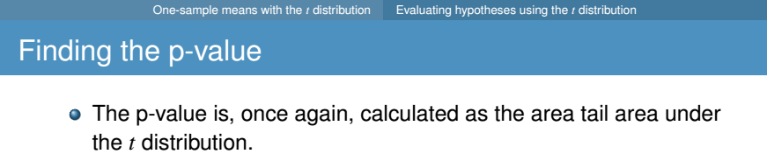


Notes:
Conclusion:
Reject the null. We have convincing evidence that there is a difference in traffic flow between Friday the 13th and Friday the 6th.

Slide 55


Slide 56




Slide 57
Finding t*
As usual, for a 95% CI, we split the 5% uncertainty between the two tails: 2.5% in each.
Use the qt(p, df) to find the cuttoff.
qt(0.025,9)
[1] -2.262157
> qt(0.975,9)
[1] 2.262157
> qt(0.025,9,lower.tail = FALSE)
[1] 2.262157

Slide 58



Slide 59


Slide 61



Note: The example we used was for paired means (difference between dependent groups). We took the difference between the observations and used only these differences (one sample) in our analysis, therefore the mechanics are the same as when we are working with just one sample.

Slide 62
t distribution for the difference of two means

Slide 63


Slide 64


Slide 65




Slide 66


Slide 67





Assuming the variances of
the samples are about the same.
Note: There is an alternative formula for the SE based on the “pooled” variance which gives a better estimate of the SE when the variances can be assumed to be roughly equal. If variances are assumed not equal, the df calculation is more complicated. The t.test() function in R will apply the correct formula if you indicate your assumption on the variances

Slide 68





Slide 69
p-value
With T=-2.508, and df = 51 how do we find the p-value?

Slide 70



Slide 71

Building a 90% CI

Slide 72







Slide 73





